Slide 1
Strategic Management
Dr. Marwa Tarek
8th class
Generating strategies

Slide 2
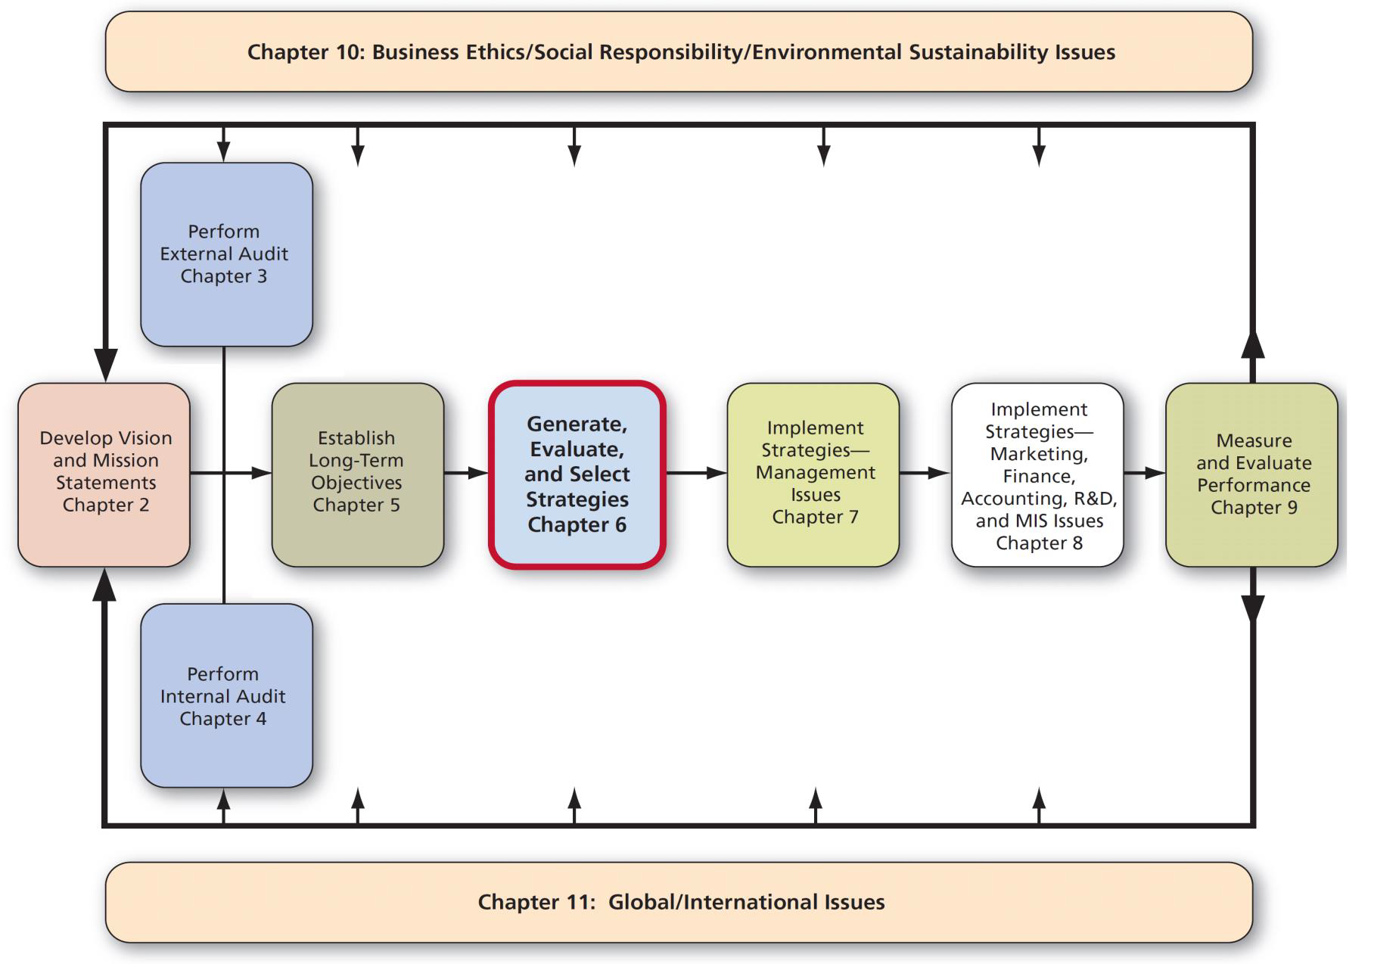
Strategy Analysis & Choice

Slide 3
Comprehensive Strategy-Formulation Framework
Stage 1 –Input Stage
EFE (External Factor Evaluation) Matrix
IFE (Internal Factor Evaluation) Matrix
Stage 2 –Matching Stage (ready to achieve the best fit)
IE Matrix
SWOT (Strengths-Weaknesses-Opportunities-Threats)
SPACE (Strategic Position & Action Evaluation)Matrix
BCG (Boston Consulting Group) Matrix
Stage 3 –Decision Stage
QSPM (Quantitative Strategic Planning Matrix)

Slide 4
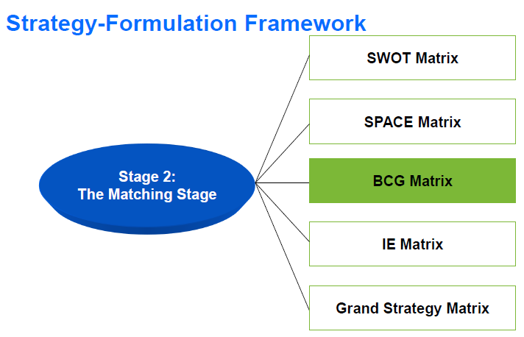

Slide 5
BCG Matrix Boston Consulting Group Matrix
BCG is an ideal matching tool if the company is a multidivisional firm.
Multidivisional refers to more than one market or different product lines.
In a multidivisional structure, there's one parent company that consists of a number of different divisions operating separate businesses. Legally, the parent company owns all of the divisions, but the parent company gives the divisions significant autonomy, which allows them to act independently.
Examples of companies applying a divisional structure are McDonald’s Corporation and Disney.

Slide 6
BCG Matrix Boston Consulting Group Matrix
When a firm’s divisions compete in different industries, a separate strategy often must be developed for each business.
The BCG Matrix is designed specifically to enhance a multidivisional firm’s efforts in formulating strategies.
It focuses only on relative market-share position as a single internal dimension and
the industry growth rate as a single external dimension.

Slide 7
BCG Matrix
What are the limitations of a BCG matrix?
One limitation of using the BCG matrix is it doesn’t account for any factors beyond market share and growth.
This means it won’t give you the complete picture as to why your products are succeeding or failing.

Slide 8
BCG Matrix
Two dimensions of BCG
1- Internal Dimension:
Relative market share is the division’s market share as an index of its largest competitor.
2- External Dimension:
Industry growth rate is the annual increase in revenues for several leading firms in the industry would be a good estimate of the value.

Slide 9
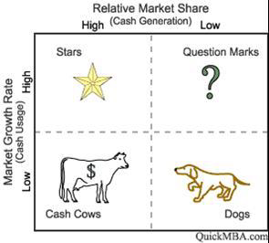
BCG Matrix Boston Consulting Group Matrix

Slide 10
BCG Matrix
Relative market share is the division’s market share as an index of its largest competitor.
In this way, relative market share becomes a comparative measure of competitive strength.
Relative Market Share =
Division’s Market Share/Largest Competitor’s Market Share
For example, if a firm has a market share of 20% and their largest competitor has a 40% market share, then the division ’s relative market share would be 0.5 (that is, 20%/40%).
As another example, if a division was the market leader and had a market share of 30% and their largest competitor had a market share of 20%, then their relative market share would be 1.5 (30%/20%)

Slide 11
BCG Matrix Relative market-share position
 | Own Market Share | Largest Competitor Mkt Share | Relative Market Share
Division A | 50% | 30% | 1.67
Division B | 60% | 50% | 1.20
Division C | 20% | 50% | 0.40
This gives Division (A) a relative market share of 1.67 and Division (B) 1.5. i.e. they are the market leaders. However, Division (C) is compared to its largest competitor and its relative market share is 0.40 . In this case, by definition, its relative market share will be less than 1.0 because it is not the market leader and doesn't have the largest market share.

Slide 12
BCG Matrix
When Relative market share is equal to or greater than 0.5, (High) it is likely to be classified as stars and cash cows.
When Relative market share is less than 0.5, (low) it is likely to be classified as question marks and dogs.

Slide 13
BCG Matrix
Industry growth rate is the annual increase in revenues for several leading firms in the industry would be a good estimate of the value.
Industry Growth Rate % =
Total Sales of Current Year - Total Sales of previous Year
Total Sales of Previous Year

Slide 14
BCG Matrix Industry growth rate
 | Last Year | Current Year | Growth Rate
Division A | 10,000,000 | 12,000,000 | 20.0%
Division B | 10,000,000 | 10,500,000 | 5.0%
Division C | 10,000,000 | 8,000,000 | -20.0%
Market growth rates in excess of 20% per year are reflective of the introduction and growth stage of the product lifecycle and would be classified as either stars or question marks.
Whereas markets growing by less than 20% a year (or perhaps even negative) would be in the maturity or decline stage of the product lifecycle and would include portfolios that would be classified as either cash cows or dogs.

Slide 15
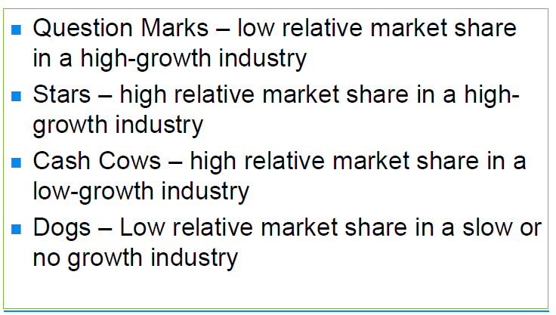
BCG Matrix

Slide 16
BCG Matrix
Each of the four quadrants represents a specific combination of relative market share, and growth:
Cash cows
Low Growth, High Share. Companies should milk these “cash cows” for cash to reinvest.
Out of many products, a particular product becomes responsible for generating a huge chunk of profits for a company.
Such products are called cash cows or moneymakers.

Slide 17
BCG Matrix
Stars
High Growth, High Share. Companies should significantly invest in these “stars” as they have high future potential.
The business units or products with the best market share and generating the most cash are considered Stars.
Monopolies and first-to-market products are frequently termed Stars too.

Slide 18
BCG Matrix Question marks
High Growth, Low Share. Companies should invest in or discard these “question marks,” depending on their chances of becoming stars.
Question marks are the most managerially intensive products and require extensive investment and resources to increase their market share. Investments in question marks are typically funded by cash flows from the cash cow quadrant.

Slide 19
BCG Matrix Dogs
Low Share, Low Growth. Companies should liquidate, divest, or reposition these “pets.”
Products in the dogs quadrant are in a market that is growing slowly and where the product(s) have a low market share.
Firms typically phase out products in the dogs quadrant.

Slide 20
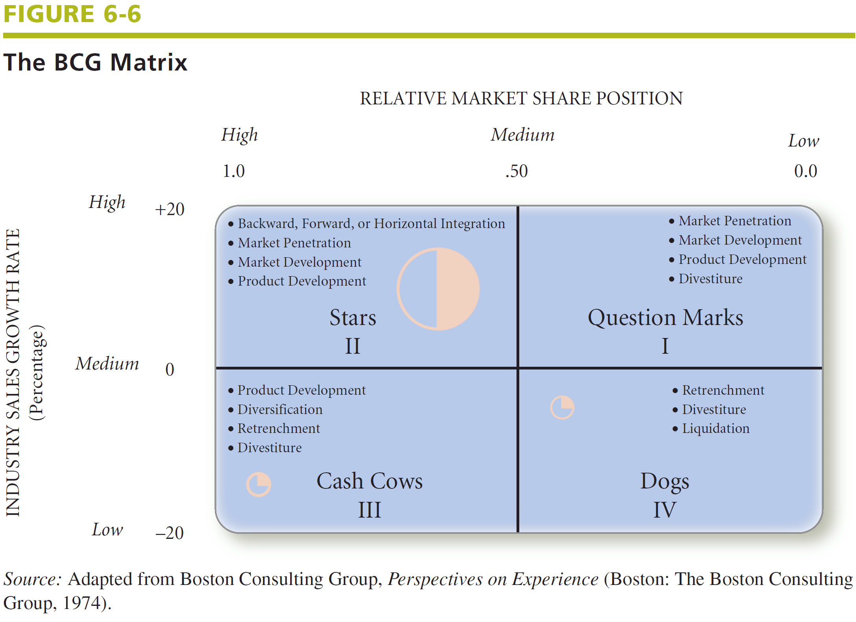
BCG Matrix

Slide 21
BCG Matrix
Three important observations of figure (6-6)
1- There are three circles only
This means that there are three divisions in this company (i.e. 3 product lines, 3 markets, 3 types of customers,….).
2- There are different sizes of circles
This means that the size of the circle represents the revenues generated by a specific division, (e.g. the highest revenue is generated from the division located at stars quadrant).
3- Each circle has two slices
The shaded one represents the profits generated by the division.

Slide 22
BCG Matrix
%Growth rate | % Market share | % Profits | Profits | Expenses | % Revenues | Revenues | Divisions
20.0% | 1.67 | 50% | $30000 | ($40000) | 58% | $70000 | Division A
5.0% | 1.50 | 33% | $20000 | ($10000) | 25% | $30000 | Division B
-20.0% | 0.40 | 17% | $10000 | ($10000) | 17% | $20000 | Division C
 |  | 100% | $60000 | ($60000) | 100% | $120000 | Total

Slide 23
BCG Matrix
Notes
1- How many circles that we have?
3 circles as we have 3 divisions
2- Where can we locate them?
Division A: Stars
Division B: Cash cows
Division C: Dogs

